Slide 1

February 10, 2015
Network Analysis and Security Monitoring with WAW Technologies
WAW Technologies Inc.

Slide 2
Agenda
About WAW Technologies Inc.
Monitoring And Visibility Requirements
Current Solutions And Challenges
Next Generation Network Monitoring Device
Future Development Plans
Demos
Q&A
Door Prize

Slide 3
About WAW Technologies
Launched in March 2014 by Alexander Zakharov and Robert Venczel
IT security technology company located as part of VENUS Cybersecurity Corporation in Orleans.
Current focus is on developing small form factor intelligent security appliances, architected to integrate with existing network and security tools and vendors.
Successfully completed Kickstarter project in December 2014 (LUNA – Little Universal Network Appliance)
Notes:
VENUS - Virtual Environment for Networks of Ubiquitous Security

Slide 4
Monitoring And Visibility Requirements
Advanced Threat Detection
Network Visibility And Security
Compliance (HIPAA, PCI, FISMA, SCADA, ITSG-33)
Network Troubleshooting And Planning
Forensics And Investigations
Industrial Process Monitoring
Notes:
Forensics and Investigations: continuous, flow-based information; attack history reconstruction; reporting on one, or on multiple users
Advanced Threat Detection: internal IDS; data leakage; botnet detection; worm detection
Network Visibility and Security: communication monitoring; data leakage
Compliance: HIPAA; PCI; FISCA; SCADA; ITSG-33; QoS monitoring
Network Troubleshooting and Planning: enterprise-wide view of network traffic usage; planning for capacity upgrades and elimination of bottlenecks
Industry: continuous industrial process monitoring

Slide 5
Monitoring And Visibility Solutions
Network monitoring is usually a host-based software solution or specialized hardware
SPAN/MIRROR Port Monitoring
Network TAP
Metadata, partial or full data capture for analysis and remediation (WireShark, Plixer Scrutinizer, IdealData NetFlow Auditor, Flowtraq, PaloAlto Panorama, SolarWinds NTA etc.)
Wide choice of metadata capture options (NetFlow, S-Flow, J-FLow, IPFIX, IP headers etc.)

Slide 6
Monitoring And Visibility Challenges
IT trends drive scale and complexity
Network discontinuity impacts network operations
Enterprises deploy more network mgmt. and security tools
Network mgmt, and security tools need network visibility
Visibility requirements lead to greater use of SPAN/mirror ports and taps
Greater use of SPAN/mirror ports and taps leads to scaling/visibility issues
Next Generation of Network Monitoring Devices
Notes:
SPAN Port Monitoring
Most switches cannot feasibly support more than two SPAN ports.
SPAN ports can create:
Additional performance issues
Changes in the architecture that also introduce performance and potential security gaps
Network Taps for Monitoring
Many taps do not have port density necessary for advance deployment
Multiple management requirements increase operational overhead
Lack of granularity
High cost

Slide 7
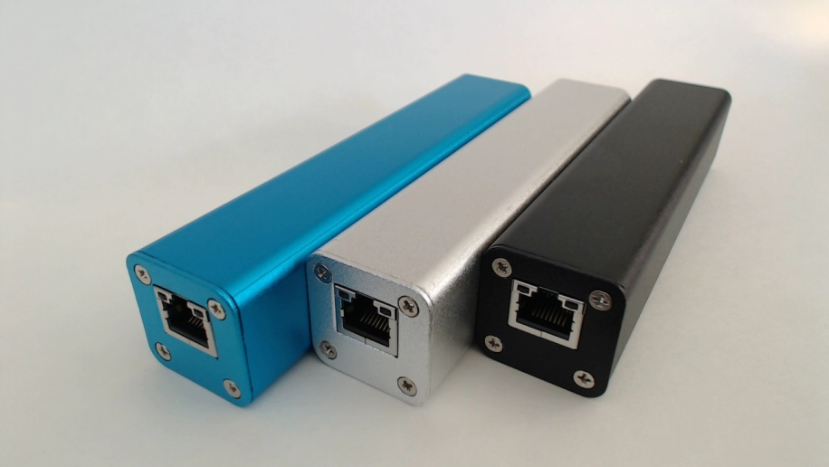
LUNA – Network Security Monitoring Device

Slide 8
LUNA Specs And Features
ARM A8 Core 1GHz
512MB RAM, 1GB – 64GB Flash Memory
2 x Gigabit Network Interfaces
Built-In 3-Way Switching Fabric (max 800ns latency on full duplex gigabit line speed)
Dual Gigabit MAC or Transparent Switching Bridge Configuration Options
PoE+ or USB Bus Powered
USB 2.0 Host Interface For Flexible Extension Options

Slide 9
Hardware Development
Fail-safe feature on power loss
Optical interfaces through SFP cages
10Gb interface support
Build-in HSM module (hardware security module for real-time encryption/decryption)
Up to 8 DSP cores to enable more sophisticated processing
Flexible memory options and more powerful processor
Expanded storage capacity through PCI express and/or USB 3.0
Flexible out-of-band wireless options (WiFi 802.11 a/b/g/n/ac, Xbee 802.15.4, GSM/GPRS/LTE/UMTS, ISM 400MHz and 900MHz etc.)
True PoE pass-through functionality (PoE bridging)

Slide 10
Software Development
Kali Linux (BackTrack)
Deck Linux (hacking and penetration testing distribution for low power devices)
Ntop tools (nProbe, ntopng)
Ipt-netflow
Security Access Controls
Distributed Sensor Mesh Framework
Cloud Based Analytic Support
USERS ARE ENCURAGED TO DEVELOP THEIR OWN!
We will develop and promote a marketplace for user written applications. Monetize your ideas!

Slide 11
Demo #1: Remote Wireshark Sensor
Use Wireshark with our device and RPCAP (Remote Packet Capture) to perform remote network data captures. It enables you to run a packet capture program on our device, which will help you sniff the network traffic sent over the wire and uplink the captured packets to another host (i.e., your Wireshark PC), where the captured packets can be processed, analyzed and/or archived.

Slide 12
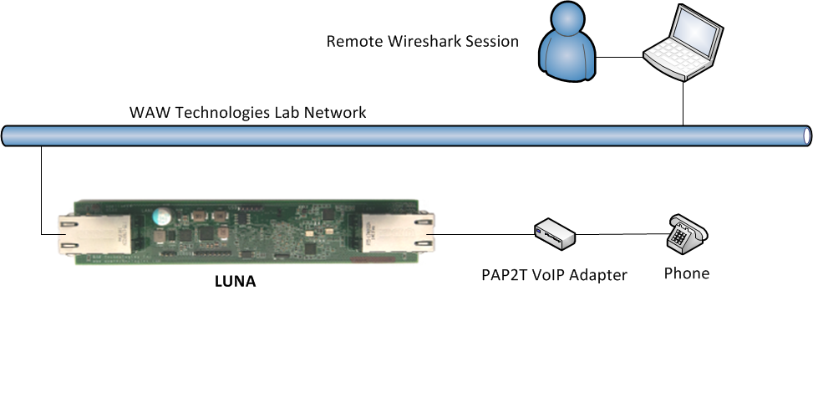
Demo #1: Remote Wireshark Sensor (continue)

Slide 13
Demo #2: Remote Wireless Wireshark Sensor (WiFi)
Remote wireless Wireshark sensor that delivers data collected from the wire over WiFi link.
LUNA in this demo serves as AP (Access Point)

Slide 14
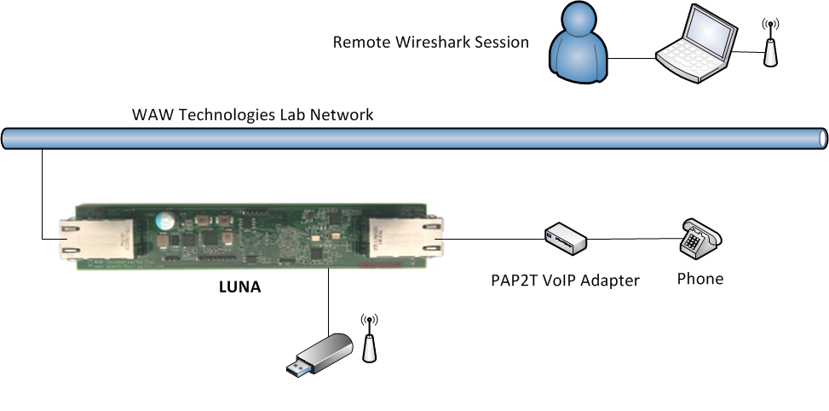
Demo #2: Remote Wireless Wireshark Sensor (WiFi)

Slide 15
Demo #3: Remote Wireless Wireshark Sensor (3G/LTE)
Remote wireless Wireshark sensor that delivers data collected from the wire over 3G/LTE.
Wireless without boundaries…

Slide 16
Demo #3: Remote NetFlow Exporter
If time permits…
LUNA as NetFlow exporter using nProbe software
Plixer Scrutinizer as Analytics Platform

Slide 17
Door Prize
Door prize for the January 12th HTCIA Training Day event:
Two LUNA prototype
KALI Linux pre-installed
+ One-on-one, hands on training

Slide 18
Questions?

Slide 19
Contact
Alexander Zakharov
alex@wawtechnologies.com
Robert Venczel
robert@wawtechnologies.com
WAW Technologies Inc.
www.wawtechnologies.com
613-366-3055

